Slide 1
House Prices Predictions
Made by prestige international Real Estate Company
GetYourHome
Real Estate Analysts: Chloe & Mariya

Slide 2


Our Real Estate Price prediction model used dataset from King County Washington USA

Slide 3
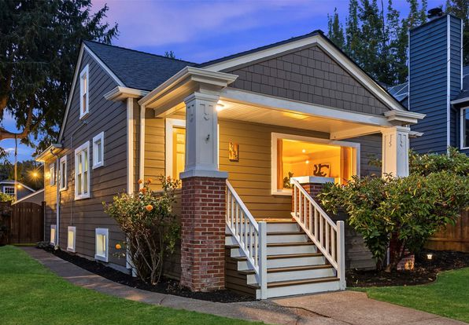

Dataset
Our analysis is based on 21 597 properties with median price of 450K $ ranging from 78K$ up to 7 700K$

Slide 4
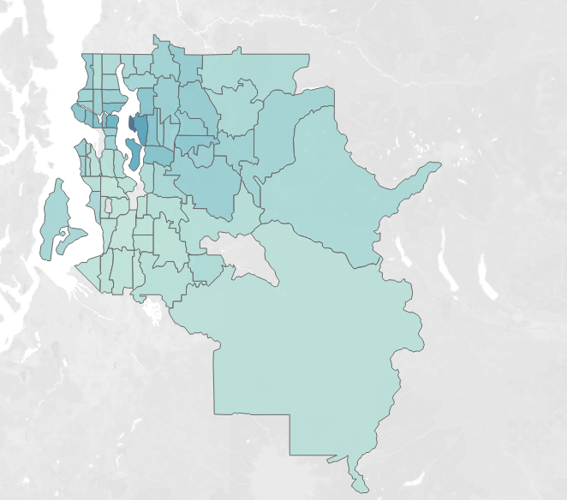

The most expensive proprieties are in Medina King County

Slide 5
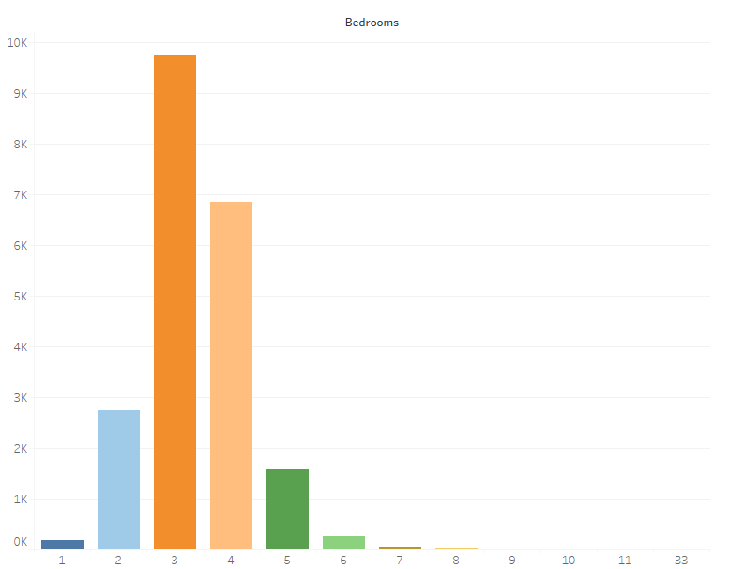
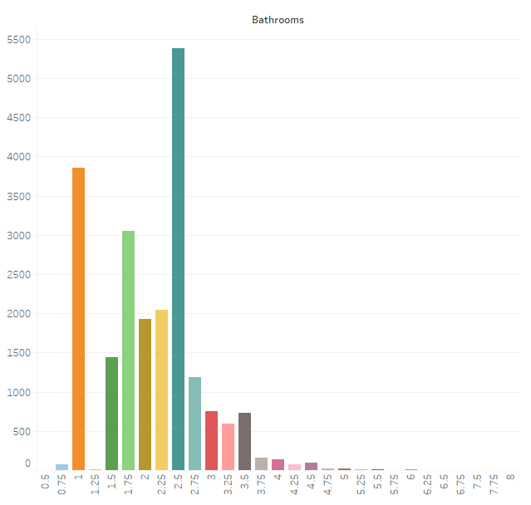
The most popular houses have: * one floor * 3-4 bedrooms * 2.5 bathrooms;

Slide 6
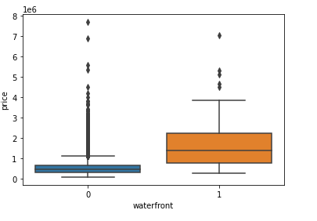
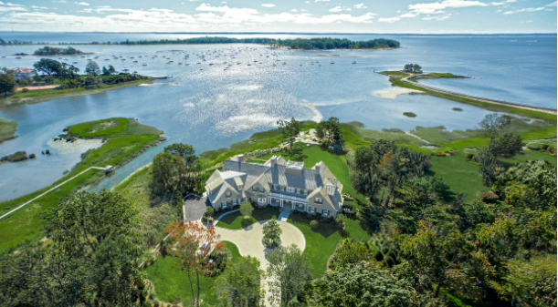
Houses with higher prices have: * waterfront view * higher grade * higher square feet living;

Slide 7
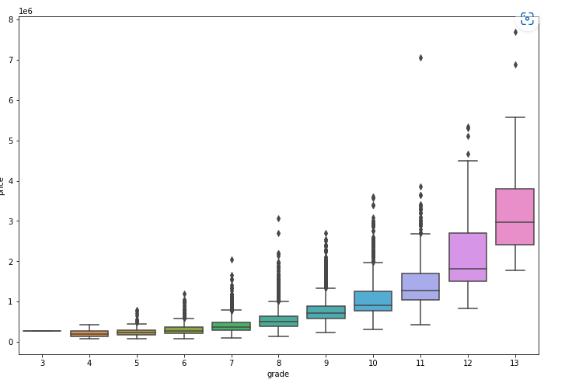
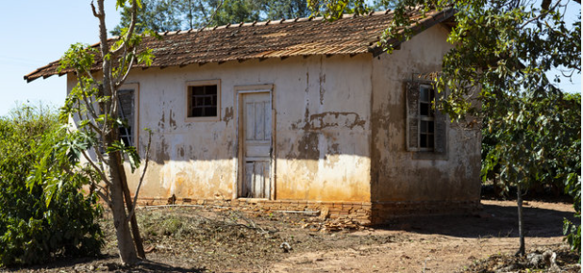
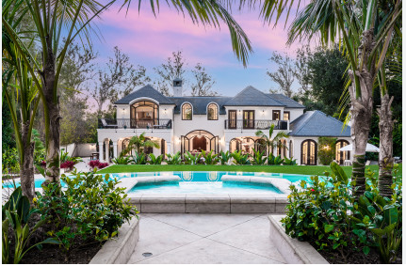
Houses with higher prices have: * waterfront view * higher grade * higher square feet living;

Slide 8
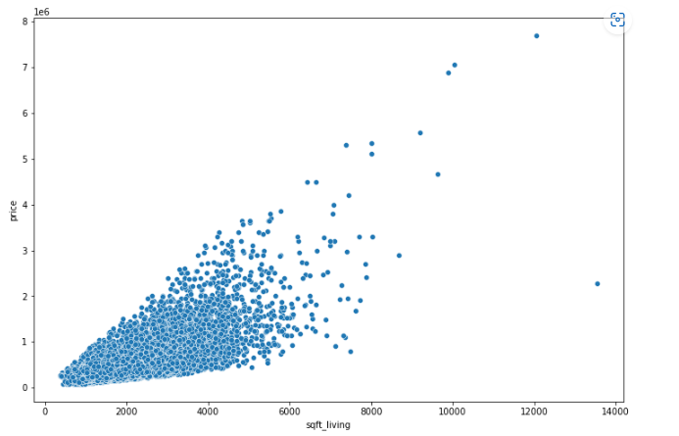
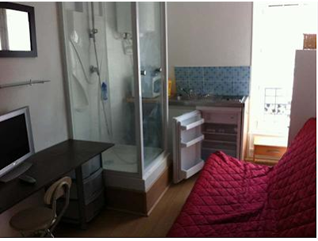
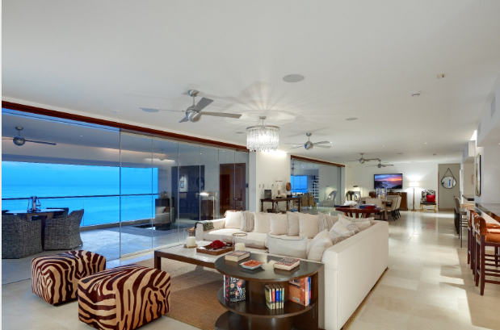
Houses with higher prices have: * waterfront view * higher grade * higher square feet living;

Slide 9
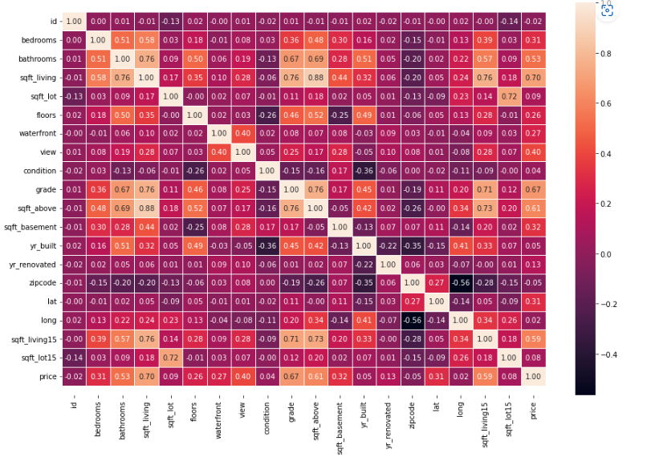
Features impacting the price

Slide 10



Models applied: * Linear Regression * KNN * Random Forest;
Linear Regression
KNN
Random Forest

Slide 11

* Linear Regression
Linear Regression before normalization and standardization
To improve our model and get more accurate results, we will apply some different pre-processing methods:
a - Standardization: values are centered around the mean with a unit standard deviation.
b - Normalization: values are rescaled so that they end up ranging between 0 and 1.
c - Dealing with outliers

Slide 12

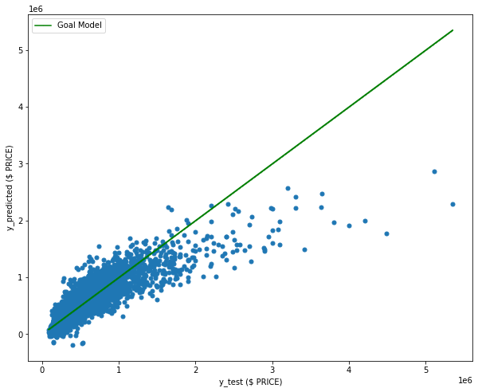
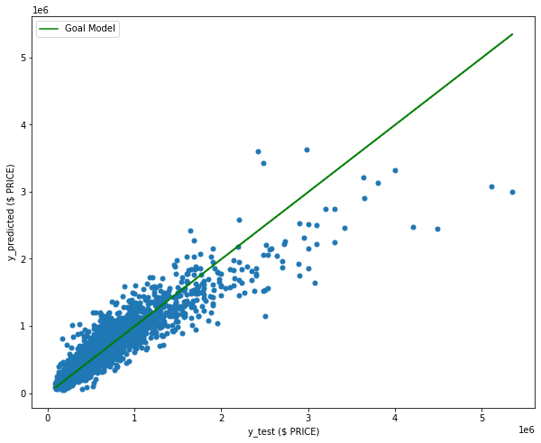
Linear Regression final results

Slide 13
WHY TO CONTACT US?
Highly professional and motivated team
Most accurate prediction model on the market
LOW COMMISIONS ☺

